Slide 1
E-COMMERCE OLIST STORE ANALYSIS

Slide 2
TOPICS
1. Introduction
2. Overview
3. KPIs
4. Insights & Recommendations
5. Conclusion

Slide 3
OVERVIEW
The olist store analysis project aims to analyze customer purchasing patterns and payment statistics on an e-commerce platform, Olist. This project covers several key performance indicators (KPIs) such as weekday vs weekend sales, payment statistics, delivery time, and customer behavior. The analysis is based on nine csv files, which are cleaned and manipulated to extract valuable insights.

Slide 4
KPI’S
Weekdays and weekend payment statistics
Payment type with review score 5
Average numbers of delivery days taken for pet shop
Average price and payment value of sao paulo city
Average shipping days vs review scores

Slide 5
WEEKDAY VS WEEKEND PAYMENT STATISTICS
KPI - 1
This analysis compares customer payment activity on weekdays and weekends, offering insights into buyer behavior and paymnent preferences. Weekday payments: 12,703,545 transactions (77%). Weekend payments: 3,762,009 transactions (23%) this KPI answers questions like, which day of the week has the highest sales? The analysis of this KPI can help olist to improve their weekend sales and plan promotions accordingly.

Slide 6
PAYMENT TYPE WITH REVIEW SCORE 5
KPI - 2
Number of orders with review score as 5 and payment type as credit card. This kpi analyses the number of orders with a review score of 5 and payment type as credit card. This helps in understanding customer satisfaction levels and payment preferences. Olist can use this information to identify satisfied customers and encourage them to make repeat purchases.

Slide 7
AVERAGE NUMBER OF DELIVERY DAYS TAKEN FOR PET SHOP
KPI - 3
This kpi analyzes the average number of days taken for order_ delivered_customer_ date for pet_shop. It helps olist in identifying areas where they can improve their delivery time and maintain customer satisfaction.

Slide 8
AVG PRICE & PAYMENT FOR SAOPAULO
KPI - 4
The analysis of average price and payment values from customers of Sao Paulo city helps in understanding the spending patterns of customers in this region. It also helps Olist in identifying high-value customers and creating targeted marketing campaigns.

Slide 9
AVERAGE SHIPPING DAYS VS REVIEW SCORES
KPI - 5
This KPI analyzes the relationship between shipping days and review scores. It helps in understanding the impact of delivery time on customer satisfaction levels. Olist can use this information to optimize their logistics and improve their delivery time.

Slide 10

MS EXCEL DASHBOARD

Slide 11
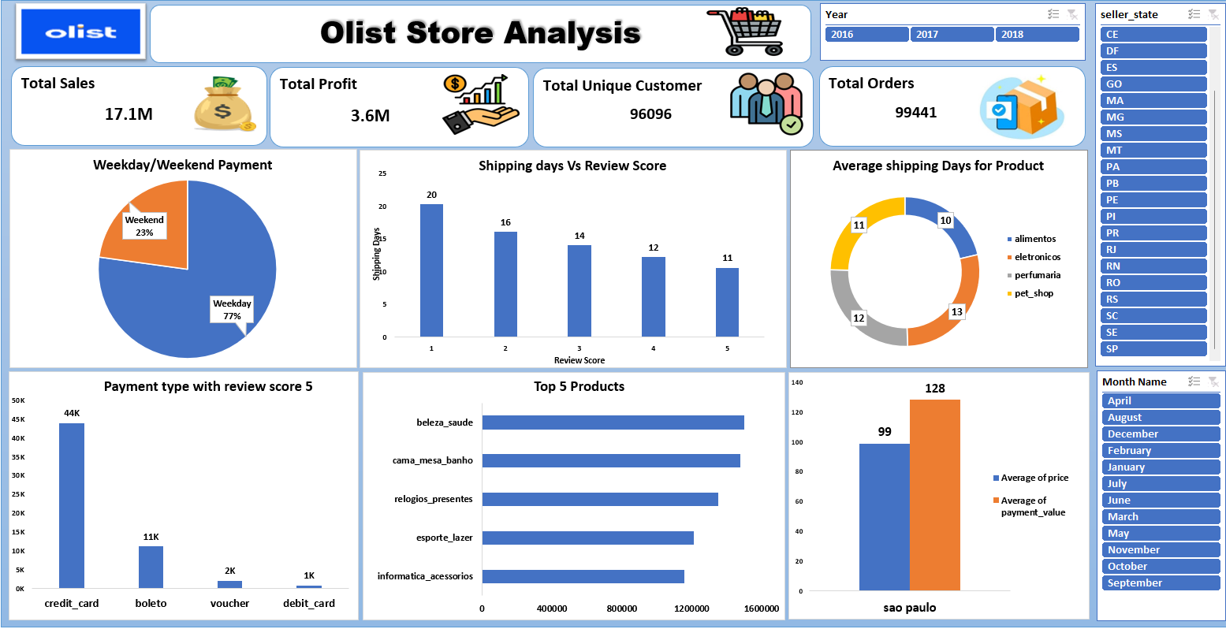

Slide 12

POWER BI DASHBOARD

Slide 13
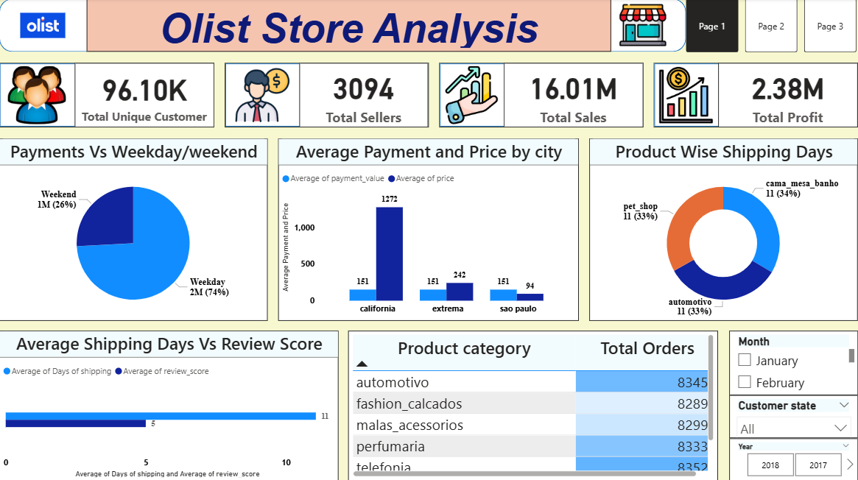

Slide 14
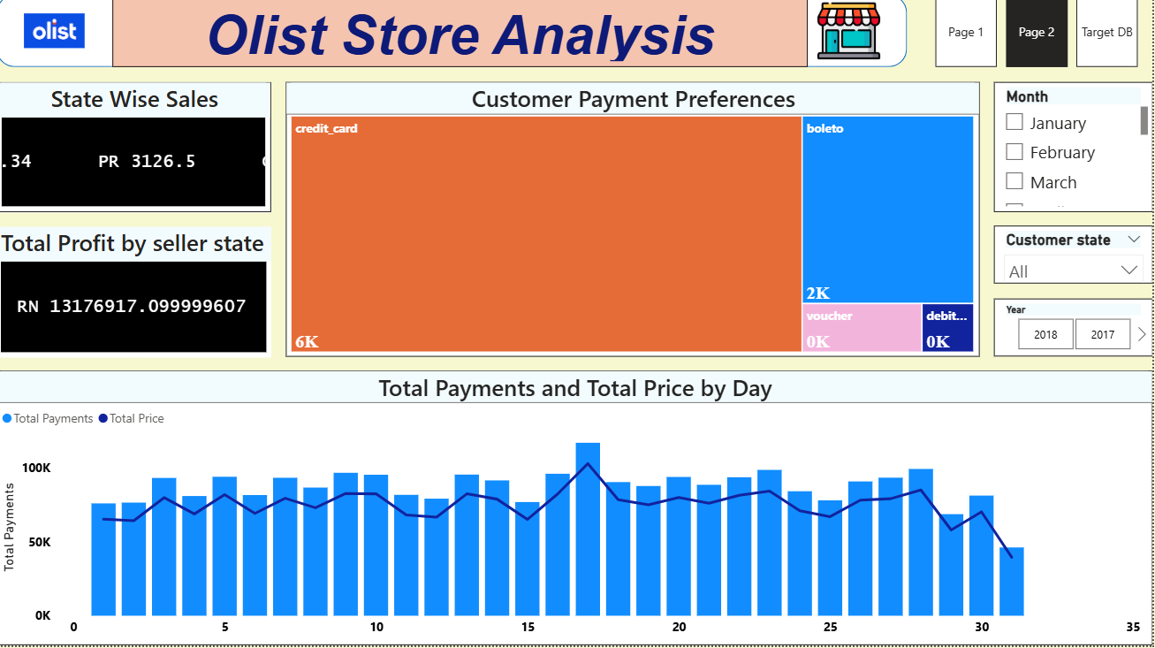

Slide 15

TABLEAU DASHBOARD

Slide 16
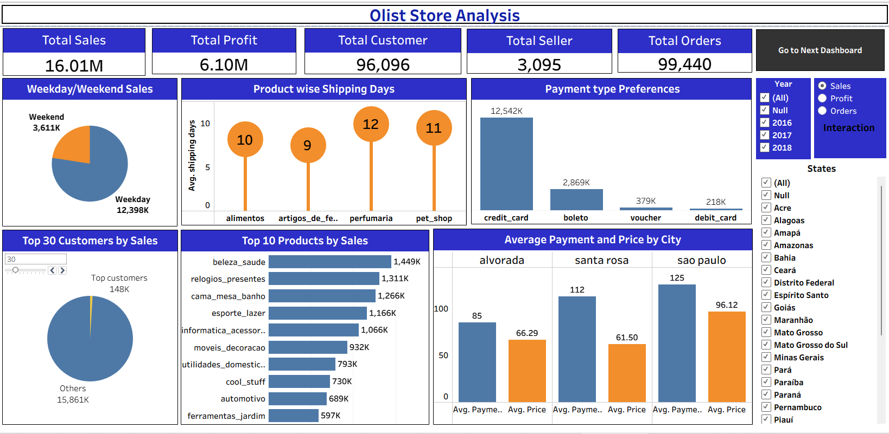

Slide 17
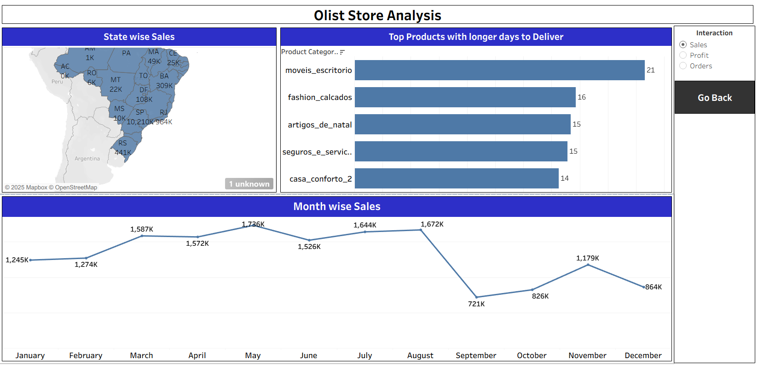

Slide 18

SQL QUERY

Slide 19
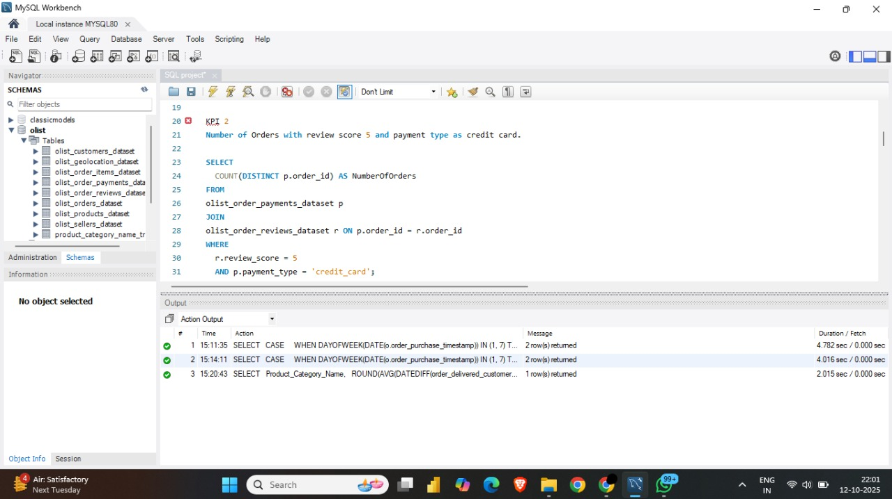
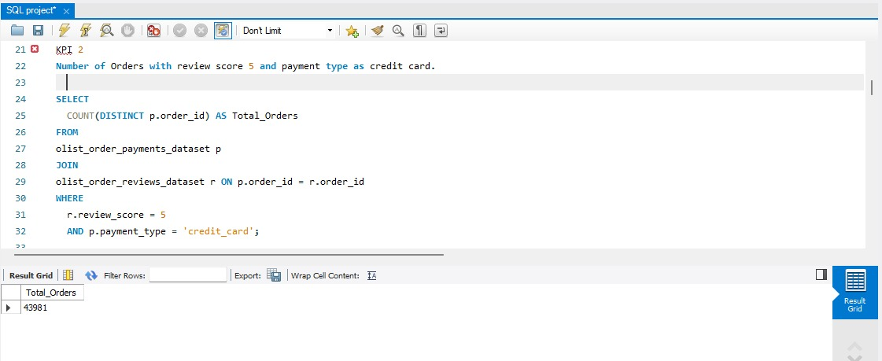
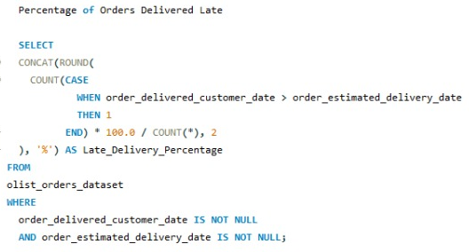
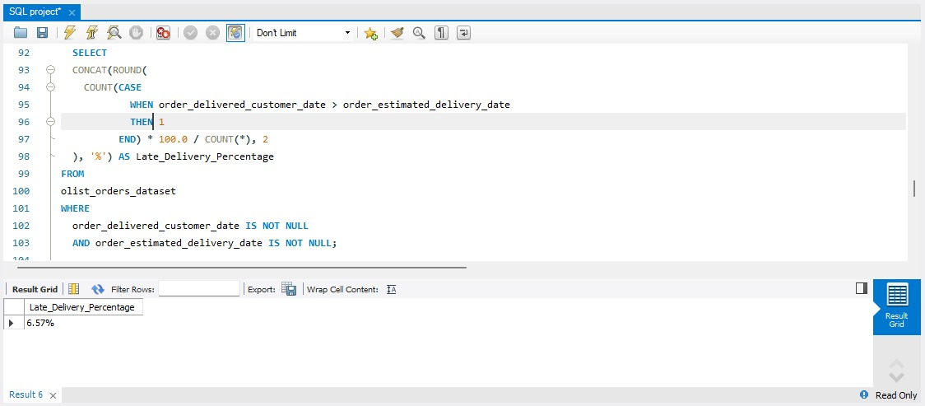
KPI-1 NUMBER OF ORDERS WITH REVIEW SCORE 5 AND PAYMENT TYPE AS CREDIT CARD
KPI-2 PERCENTAGE OF ORDERS DELIVERED LATE
OUTPUT :
OUTPUT :

Slide 20
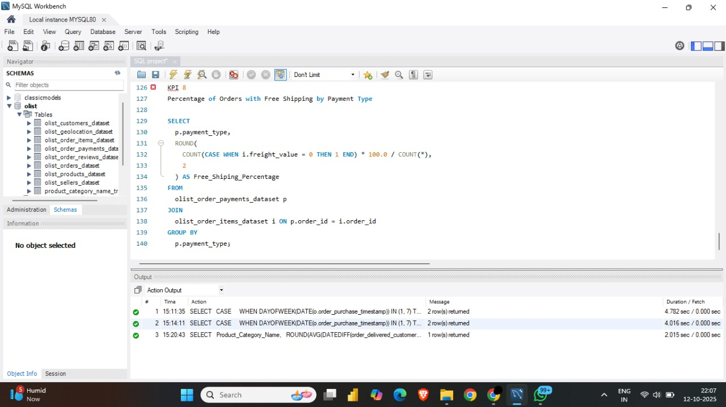
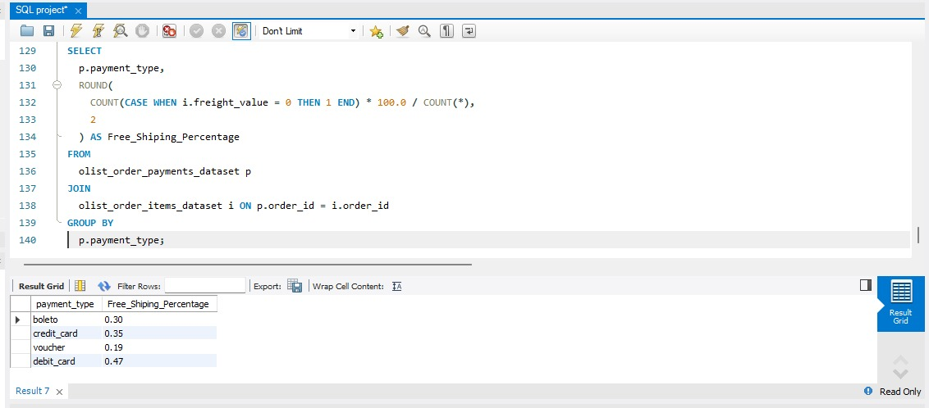
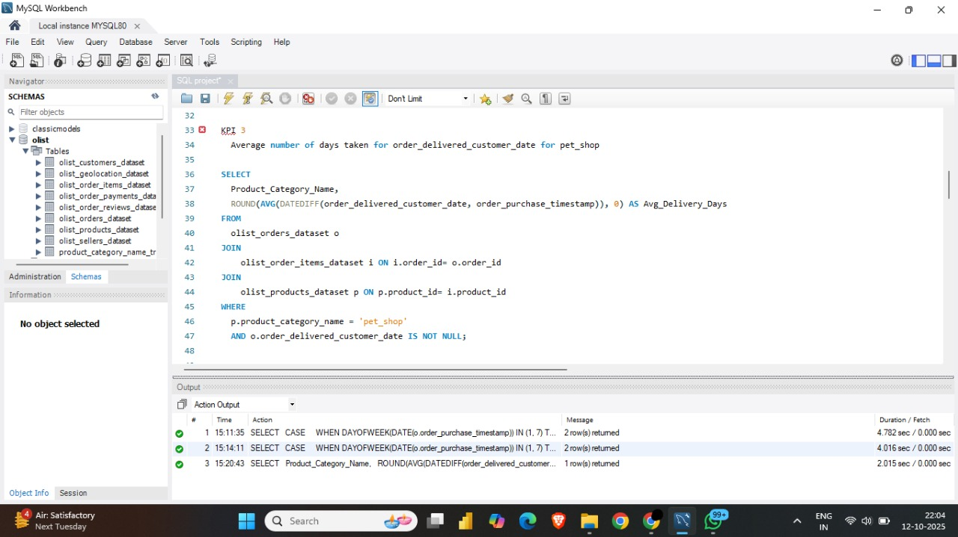
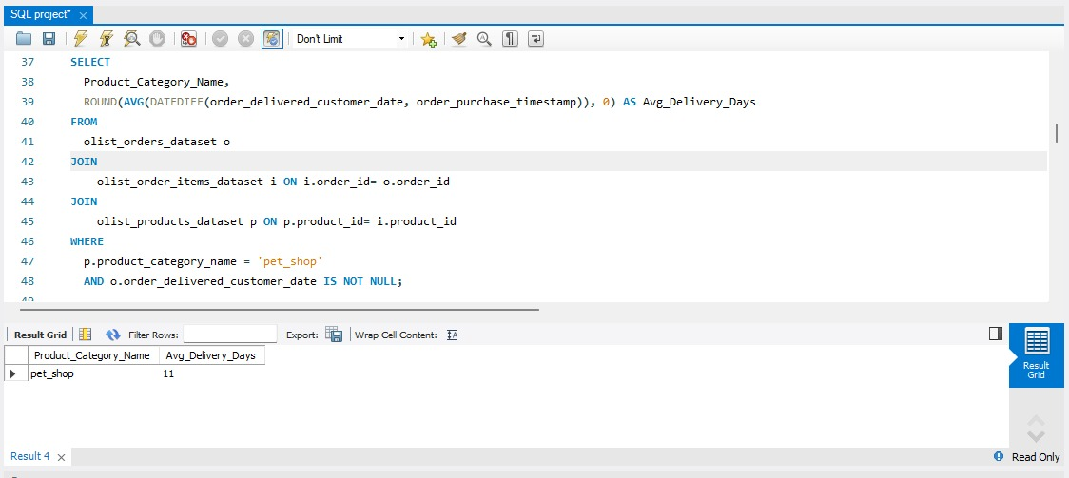
KPI-3 PERCENTAGE OF ORDERS WITH FREE SHIPPING BY PAYMENT TYPE
OUTPUT :
KPI-4 AVERAGE DELIVERY TIME FOR PET SHOP
OUTPUT :

Slide 21
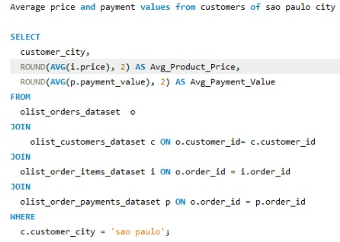
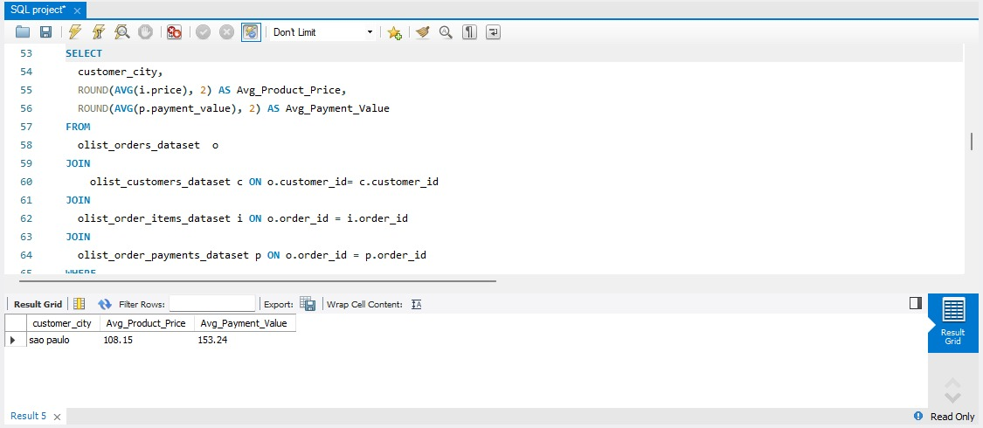
KPI-5 AVERAGE PRICE AND PAYMENT VALUES FROM CUSTOMERS OF SAO PAULO CITY
OUTPUT :

Slide 22
INSIGHTS
Healthy Business Performance: Strong sales (16.1M) with solid profit (2.38M).
Customer Retention Opportunity: Orders are nearly equal to customers, indicating low repeat purchases.
Sales Concentration on Weekdays: 77% of sales occur on weekdays; weekends show growth potential.
Delivery Speed Matters: Faster shipping significantly improves customer review scores.
Logistics Bottleneck: Electronics category has the highest average delivery time.
Payment Preference: Credit cards are the most used payment method for 5-star reviews.
Top Revenue Categories: Beauty & Health, Home & Bath, and Gifts lead sales.
Regional Insight: São Paulo shows higher payment value than product price, indicating multi-item purchases.
Action Focus: Improve logistics, increase weekend promotions, and drive repeat purchases.

Slide 23
RECOMMENDATIONS
Reduce delivery time to improve customer ratings
Increase repeat sales through loyalty offers
Run weekend-focused promotions
Improve logistics for electronics category
Invest more in top-selling products
Promote digital and credit card payments
Expand strategies from high-performing regions
Optimize shipping and operational costs

Slide 24
SUMMARY
Overall, regular monitoring of customer reviews, real-time tracking of fleet performance, together with proper shipment tracking and a communication system can improve Olist's delivery and supply chain performance and ensure customers are highly satisfied with the service.

Slide 25
CONCLUSION
The olist store analysis project provides valuable insights into customer behavior and payment statistics. The analysis of these KPIs helps Olist in identifying areas of improvement and creating targeted marketing campaigns. As a data analyst, I have used excel and mysql to clean and manipulate the dataset and create meaningful visualizations. This project serves as a great example of how data analysis can help businesses make informed decisions.

Slide 26


